Slide 1
Chapter 9
Object-Relational DBMSs

Slide 2
Chapter 9 - Objectives
Requirements for advanced database applications.
Why RDBMSs currently are not well suited to supporting such applications.
Problems associated with storing objects in a RDB.
Object-oriented features in SQL:2011:
row types;
user-defined types and user-defined routines;
polymorphism;
inheritance;
reference types and object identity;
collection types (ARRAYs, MULTISETs, SETs, and LISTs);
extensions to the SQL language to make it computationally complete;
triggers;
BLOBs and CLOBs;
recursion.
Object-oriented extensions to Oracle.
2

Slide 3
Advanced Database Applications
Computer-Aided Design/Manufacturing (CAD/CAM)
Computer-Aided Software Engineering (CASE)
Network Management Systems
Office Information Systems (OIS) and Multimedia Systems
Digital Publishing
Geographic Information Systems (GIS)
Interactive and Dynamic Web sites
3

Slide 4
Computer-Aided Design (CAD)
Stores data relating to mechanical and electrical design, for example, buildings, airplanes, and integrated circuit chips.
Designs of this type have some common characteristics:
Data has many types, each with a small number of instances.
Designs may be very large.
Design is not static but evolves through time.
Updates are far-reaching.
Involves version control and configuration management.
Cooperative engineering.
4

Slide 5
Advanced Database Applications
Computer-Aided Manufacturing (CAM)
Stores similar data to CAD, plus data about discrete production.
Computer-Aided Software Engineering (CASE)
Stores data about stages of software development lifecycle.
5

Slide 6
Network Management Systems
Coordinate delivery of communication services across a computer network.
Perform such tasks as network path management, problem management, and network planning.
Systems handle complex data and require real-time performance and continuous operation.
To route connections, diagnose problems, and balance loadings, systems have to be able to move through this complex graph in real-time.
6

Slide 7
Office Information Systems (OIS) and Multimedia Systems
Stores data relating to computer control of information in a business, including electronic mail, documents, invoices, and so on.
Modern systems now handle free-form text, photographs, diagrams, audio and video sequences.
Documents may have specific structure, perhaps described using mark-up language such as SGML, HTML, or XML.
7

Slide 8
Digital Publishing
Can store books, journals, papers, and articles electronically and deliver them over high-speed networks to consumers.
Can also handle multimedia documents consisting of text, audio, image, and video data and animation.
Amount of information available to be put online is in the order of petabytes (10¹⁵ bytes), making them largest databases DBMS has ever had to manage.
8

Slide 9
Geographic Information Systems (GIS)
GIS database stores spatial and temporal information, such as that used in land management and underwater exploration.
Much of data is derived from survey and satellite photographs, and tends to be very large.
Searches may involve identifying features based, for example, on shape, color, or texture, using advanced pattern-recognition techniques.
9

Slide 10
Interactive and Dynamic Web Sites
Online catalog for selling clothes maintains preferences for previous visitors and allows visitor to:
obtain 3D rendering of any item based on color, size, fabric, etc.;
modify rendering to account for movement, illumination, backdrop, occasion, etc.;
select accessories to go with the outfit, from items presented in a sidebar;
Need to handle multimedia content and to interactively modify display based on user preferences and user selections. Added complexity of providing 3D rendering.
10

Slide 11
Weaknesses of RDBMSs
Poor Representation of “Real World” Entities
Normalization leads to relations that do not correspond to entities in “real world”.
Semantic Overloading
Relational model has only one construct for representing data and data relationships: the relation. The relationships between entities are represented by the foreign keys (within the relations).
Relational model is semantically overloaded.
11

Slide 12
Weaknesses of RDBMSs
Poor Support for Integrity and General Constraints
Homogeneous Data Structure
Relational model assumes both horizontal and vertical homogeneity.
Horizontal homogeneity means that each tuple of a relation must be composed of the same attributes
Vertical homogeneity means that each value in the particular column must be from the same domain.
12

Slide 13
Weaknesses of RDBMSs
Poor Support for Multimedia data (images/videos/sounds)
Binary Large Objects
Many RDBMSs now allow Binary Large Objects (BLOBs).
13

Slide 14
Weaknesses of RDBMSs
Limited Operations
RDBMSs only have a fixed set of operations which cannot be extended (set and tuple-oriented operations).
Difficulty Handling Recursive Queries
Extremely difficult to produce recursive queries.
Extension proposed to relational algebra to handle this type of query is unary transitive (recursive) closure operation.
Example: “supervisor of my supervisor is my supervisor”
14

Slide 15
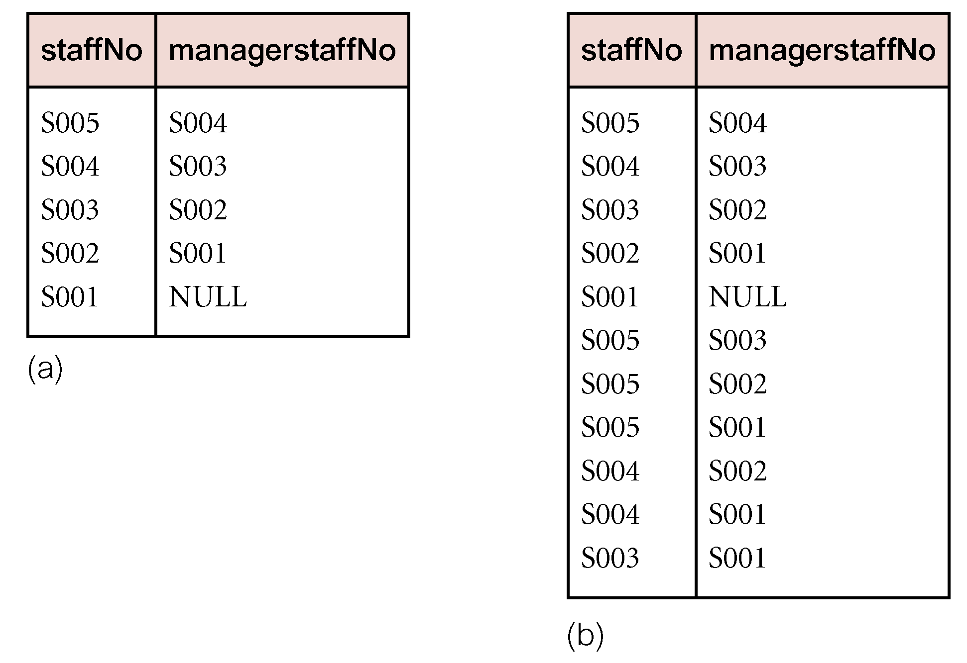
Example - Recursive Query
15

Slide 16
Weaknesses of RDBMSs
Impedance Mismatch
Most DMLs lack computational completeness.
To overcome this, SQL can be embedded in a high-level 3GL.
This produces an impedance mismatch - mixing different programming paradigms.
Estimated that as much as 30% of programming effort and code space is expended on this type of conversion.
16

Slide 17
Weaknesses of RDBMSs
Other Problems with RDBMSs
Transactions are generally short-lived and concurrency control protocols not suited for long-lived transactions.
Schema changes are difficult.
RDBMSs are poor at navigational access (very large join operations).
17

Slide 18
Storing Objects in Relational Databases
One approach to achieving persistence with an OOPL is to use an RDBMS as the underlying storage engine.
Requires mapping class instances (i.e. objects) to one or more tuples distributed over one or more relations.
To handle class hierarchy, have two basics tasks to perform:
(1) design relations to represent class hierarchy;
(2) design how objects will be accessed.
18

Slide 19
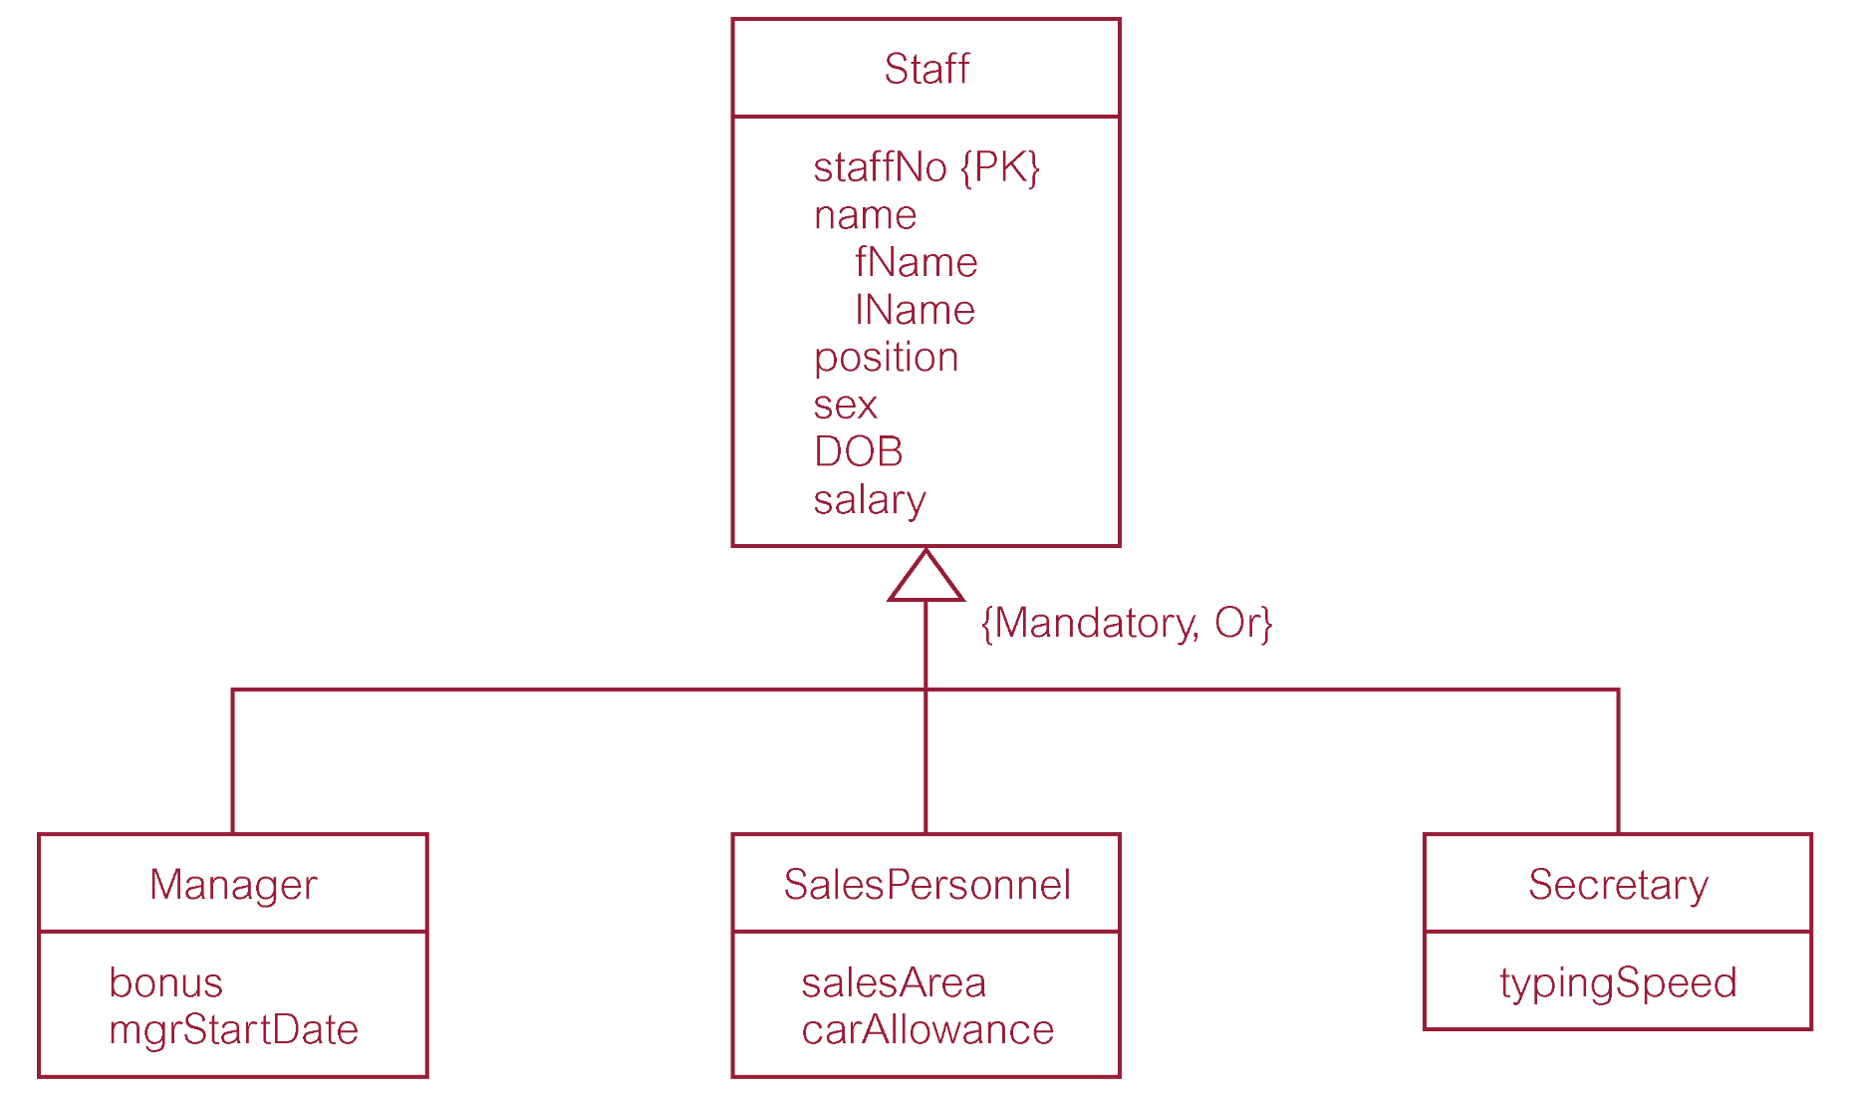
Storing Objects in Relational Databases
19

Slide 20
Mapping Classes to Relations
Number of strategies for mapping classes to relations, although each results in a loss of semantic information.
(1) Map each class or subclass to a relation:
Staff (staffNo, fName, lName, position, sex, DOB, salary)
Manager (staffNo, bonus, mgrStartDate)
SalesPersonnel (staffNo, salesArea, carAllowance)
Secretary (staffNo, typingSpeed)
Position’s domain {‘Manager’, ‘Sales’, ’Secretary’}
20

Slide 21
Mapping Classes to Relations
(2) Map each subclass to a relation
Manager (staffNo, fName, lName, position, sex, DOB, salary, bonus, mgrStartDate)
SalesPersonnel (staffNo, fName, lName, position, sex, DOB, salary, salesArea, carAllowance)
Secretary (staffNo, fName, lName, position, sex, DOB, salary, typingSpeed)
(3) Map the hierarchy to a single relation
Staff (staffNo, fName, lName, position, sex, DOB, salary, bonus, mgrStartDate, salesArea, carAllowance, typingSpeed, typeFlag)
21

Slide 22
EERD –Conceptual Modeling (using PowerDesigner)
Assuming that you have to map Person inheritance hierarchy into a relational model, how many relations would you require for the new model?

Slide 23
ORDBMSs
RDBMSs currently dominant database technology with estimated sales of US$24billion in 2011, expected to grow to US$37billion by 2016 .
Vendors of RDBMSs conscious of threat and promise of OODBMS.
Agree that RDBMSs not currently suited to advanced database applications, and added functionality is required.
Reject claim that extended RDBMSs will not provide sufficient functionality or will be too slow to cope adequately with new complexity.
Can remedy shortcomings of relational model by extending model with OO features.
23

Slide 24
ORDBMSs - Features
OO features being added include:
user-extensible types (User Defined Types),
encapsulation,
inheritance,
polymorphism,
dynamic binding of methods,
complex objects including non-1NF objects,
object identity.
24

Slide 25
ORDBMSs - Features
However, no single extended relational model.
All models:
share basic relational tables and query language,
all have some concept of ‘object’,
some can store methods (or procedures or triggers).
Performance Constraints: ORDBMS converts data between an object oriented format and RDBMS format
25

Slide 26
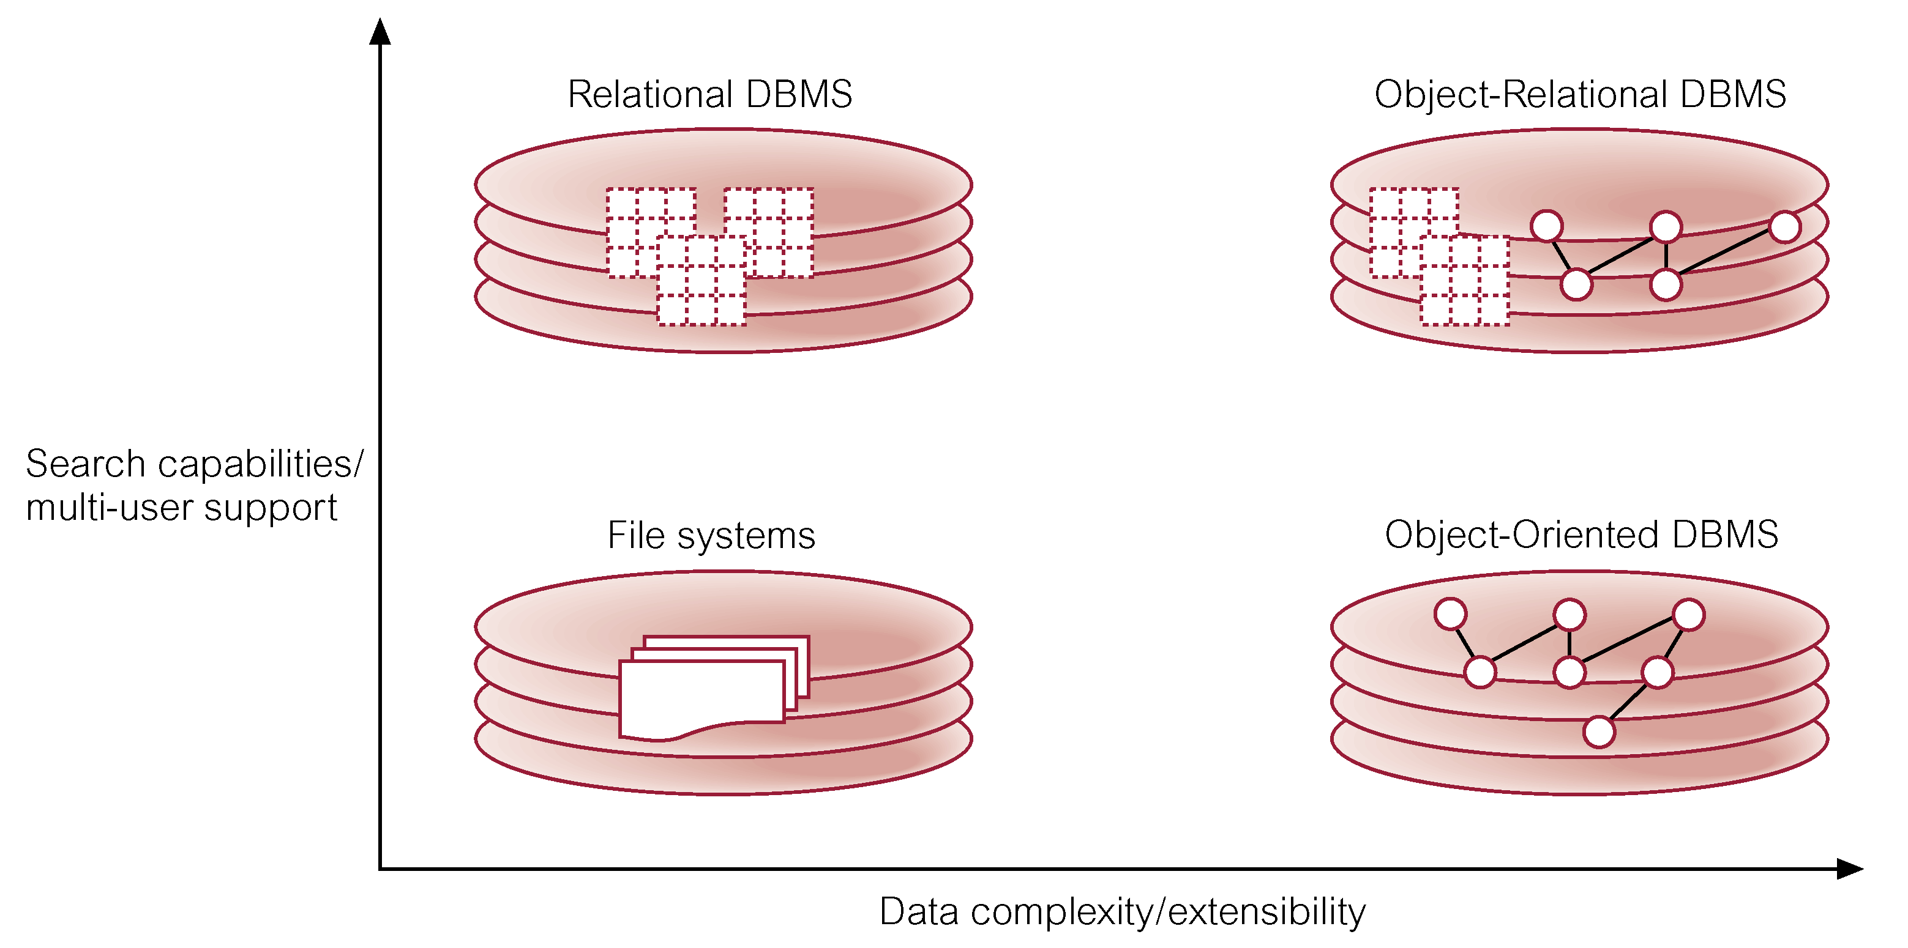
Stonebraker’s View
26

Slide 27
Advantages of ORDBMSs
Resolves many of known weaknesses of RDBMS.
Reuse and sharing:
reuse comes from ability to extend server to perform standard functionality centrally;
gives rise to increased productivity both for developer and end-user.
Preserves significant body of knowledge and experience gone into developing relational applications.
27

Slide 28
Disadvantages of ORDBMSs
Complexity.
Increased costs.
Proponents of relational approach believe simplicity and purity of relational model are lost.
Some believe RDBMS is being extended for what will be a minority of applications.
OO purists not attracted by extensions either.
SQL now extremely complex.
28

Slide 29
SQL:2011 - New OO Features
Type constructors for row types and reference types.
User-defined types (distinct types and structured types) that can participate in supertype/subtype relationships.
User-defined procedures, functions, methods, and operators.
Type constructors for collection types (arrays, sets, lists, and multisets).
Support for large objects – BLOBs and CLOBs.
Recursion.
29

Slide 30
User-Defined Types (UDTs)
SQL:2011 allows definition of UDTs.
May be used in same way as built-in types.
Subdivided into two categories: distinct types and structured types.
Distinct type allows differentiation between same underlying base types:
CREATE TYPE OwnerNoType AS VARCHAR(5) FINAL;
CREATE TYPE StaffNoType AS VARCHAR(5) FINAL;
30

Slide 31
User-Defined Types (UDTs)
Would get error if attempt to treat instance of one type as instance of other type.
Not same as SQL domains, which constrains set of valid values that can be stored.
Generally, UDT definition consists of one or more attribute definitions.
Definition also consists of routine declarations (operator declarations deferred).
Can also define equality and ordering relationships using CREATE ORDERING FOR.
31

Slide 32
Object-Oriented Extensions in Oracle
Many of the object-oriented features that appear in new SQL:2003 standard appear in Oracle in one form or another.
Oracle supports two user-defined data types:
object types;
collection types.

Slide 33
Object Types in Oracle
An object type is a schema object that has a name, a set of attributes based on the Oracle built-in data types or possibly other object types, and a set of methods.
CREATE TYPE AddressType AS OBJECT (
street VARCHAR2(25),
city VARCHAR2(15),
postcode VARCHAR2(8));

Slide 34
Object-Oriented Extensions in Oracle
CREATE TYPE StaffType AS OBJECT (
staffNo VARCHAR2(5),
fName VARCHAR2(15),
….
MAP MEMBER FUNCTION age
RETURN INTEGER,
PRAGMA RESTRICT_REFERENCES(
age, WNDS, WNPS, RNPS));

Slide 35
Object-Oriented Extensions in Oracle
CREATE TYPE BranchType AS OBJECT (
branchNo VARCHAR2(4),
address AddressType, -- UDT
MAP MEMBER FUNCTION getbranchNo
RETURN VARCHAR2(4),
PRAGMA RESTRICT_REFERENCES(
getbranchNo, WNDS, WNPS, RNDS, RNPS));

Slide 36
Object Types in Oracle
Pragma clause is a compiler directive that denies member functions read/write access to database tables and/or package variables.
Can now create a Branch (Object) table:
CREATE TABLE Branch OF BranchType
(branchNo PRIMARY KEY);

Slide 37
Methods in Oracle
Methods can be implemented in PL/SQL, Java, and ‘C’.
Overloading is supported provided their formal parameters differ in number, order, or data type.

Slide 38
Object Identifiers
Every row object in an object table has associated logical OID, which uniquely identifies the row.
The OID column is hidden from users and there is no access to its internal structure.
Oracle requires every row object to have a unique OID, which may be specified to come from the row object’s PK or to be system-generated.
CREATE TABLE Branch OF BranchType
(branchNo PRIMARY KEY)
OBJECT IDENTIFIER PRIMARY KEY;

Slide 39
Collection Types
Oracle supports two collection types: array types and table types.
An array is an ordered set of data elements, all of same data type.
Each element has an index, a number corresponding to the element’s position in the array.
An array can have a fixed or variable size, although in latter case maximum size must be specified when array type is declared.

Slide 40
Exercise for next week Nov. 23
create type address_type as object (
street varchar2(30),
city varchar2(30),
state varchar2(20),
pcode CHAR(7)
);
/
create type person_type as object (
name varchar2(30),
address address_type);
/

Slide 41
Create tables using UDT (also known as ADT)
create table employees (
eno number(4) not null primary key,
person person_type,
hdate date
);
create table customers (
cno number(5) not null primary key,
person person_type
);

Slide 42
Insert into table with UDT
insert into employees values
(1000,
person_type(‘Fred Jones',
address_type('123 Main St','Kamloops','BC’, 'V2A 1A1’)),
to_date(’12-12-1995’, ‘DD-MM-YYYY’));
insert into employees values
(1002,
person_type('John Brown',
null),
to_date(’12-12-1992’, ‘DD-MM-YYYY’));

Slide 43
Select from table with UDT
SQL> select employees.person.name from employees;
select employees.person.name from employees
*
ERROR at line 1:
ORA-00904: "EMPLOYEES"."PERSON"."NAME": invalid identifier
SQL> select e.person.name from employees e;
PERSON.NAME
------------------------------
J smith

Slide 44
Triggers
An SQL (compound) statement executed automatically by DBMS as side effect of a modification to named table.
Use of triggers include:
Validating input data and maintaining complex integrity constraints that otherwise would be difficult/impossible.
Supporting alerts.
Maintaining audit information.
Supporting replication.
44

Slide 45
Triggers
CREATE TRIGGER TriggerName
BEFORE | AFTER <triggerEvent>
ON <TableName>
[REFERENCING <oldOrNewValuesAliasList>]
[FOR EACH {ROW | STATEMENT}]
[ WHEN (triggerCondition) ]
<triggerBody>
Pearson Education © 2014
45

Slide 46
Triggers
BEFORE trigger fired before and AFTER trigger is fired after associated event occurs.
Triggered action is SQL procedure statement, which can be executed in one of two ways:
For each row (FOR EACH ROW) affected by the event. This is called a row-level trigger.
Only once for entire event (FOR EACH STATEMENT), which is default. This is called a statement-level trigger.
46

Slide 47
Triggers
As more than one trigger can be defined on a table, order of firing is important. The following order is observed:
(1) Execution of any BEFORE triggers on table.
(2) For each row affected by the statement:
Execute any BEFORE row-level trigger.
Execute the statement itself.
Apply any referential constraints.
Execute any AFTER row-level trigger.
(3) Execute any AFTER trigger on table.
47

Slide 48
Large Objects
A table field that holds large amount of data.
Three different types:
Binary Large Object (BLOB).
Character LOB (CLOB) and National CLOB.
SQL:2011 LOB slightly different from original type of BLOB that appears in many current DBMSs, where BLOB is non-interpreted byte stream.
In SQL:2011, LOB does allow some operations to be carried out in DBMS server.
48

Slide 49
Example 9.17 - Use of CLOB and BLOB
Extend Staff table to hold a resume and picture for the staff member.
ALTER TABLE Staff
ADD COLUMN resume CLOB(50K);
ALTER TABLE Staff
ADD COLUMN picture BLOB(12M);
49

Slide 50
Collection Types
Oracle supports two collection types: array types and table types.
An array is an ordered set of data elements, all of same data type.
Each element has an index, a number corresponding to the element’s position in the array.
An array can have a fixed or variable size, although in latter case maximum size must be specified when array type is declared.
50

Slide 51
Nested Tables
An unordered set of data elements, all of same data type.
It has a single column of a built-in type or an object type.
If column is an object type, table can also be viewed as a multi-column table, with a column for each attribute of the object type.
51

Slide 52
Nested Tables
CREATE TYPE NextOfKinType AS OBJECT (
fName VARCHAR2(15),
lName VARCHAR2(15),
telNo VARCHAR2(13));
CREATE TYPE NextOfKinNestedType AS
TABLE OF NextOfKinType;
Can now modify StaffType to include this new type:
nextOfKin NextOfKinNestedType
52

Slide 53
Nested Tables
Can now create Staff table:
CREATE TABLE Staff OF StaffType (
PRIMARY KEY staffNo)
OBJECT IDENTIFIER PRIMARY KEY
NESTED TABLE nextOfKin STORE AS NextOfKinStorageTable (
(PRIMARY KEY(Nested_Table_Id, lName, telNo))
ORGANIZATION INDEX COMPRESS)
RETURN AS LOCATOR;
53

Slide 54
Manipulating Object Tables
INSERT INTO Staff VALUES (‘SG37’, ‘Ann’,
‘Beech’, ‘Assistant’, ‘F’, ‘10-Nov-1960’, 12000,
NextOfKinNestedType());
INSERT INTO TABLE (SELECT s.nextOfKin
FROM Staff s
WHERE s.staffNo = ‘SG5’)
VALUES (‘John’, ‘Brand’, ‘0141-848-2000’);
54

Slide 55
Object Views
Object view is a virtual object table.
In Oracle, can create an object view that not only restricts access to some data but also prevents some methods from being invoked, such as a delete method.
Also argued that object views provide a simple migration path from a purely relational-based application to an object-oriented one, thereby allowing companies to experiment with this new technology.
55

